Slide 1
Rockbuster Stealth LLC
Launch Strategy
Prepared By:
Bethany Reed

Slide 2
Introduction
Rockbuster Stealth LLC is planning to use its existing movie licenses to launch an online video rental service in order to stay competitive in 2020. In order to do this we need to analyze a few key questions in order to proceed. To perform the analysis the data was loaded into PostgreSQL. Visualizations were created in both Tableau and Power Point.

Slide 3
Key Questions To Analyze:
What was the average rental duration for all videos?
Which movies contributed the most/least to revenue gain?
Which countries are Rockbuster customers based in?
Do sales figures vary between geographic regions?
Where are customers with a high lifetime value based?

Slide 4
1. General Statistics & Data

Slide 5
Rental Statistics
Rental Duration
Min: 3 days
Max: 7 days
Avg: 4.98 days
Rental Cost
Min: $.99
Max: $4.99
Avg: $2.98
Movie Length
Min: 46 min
Max: 185 min
Avg: 115 min
Cost to Replace
Min: $9.99
Max: $29.99
Avg: $19.98

Slide 6
Top 10 Categories (based on revenue)
Most Rented Rating:
PG-13
Category | Revenue
Sports | $4892.19
Sci-Fi | $4336.01
Animation | $4245.31
Drama | $4118.46
Comedy | $4002.48
New | $3966.38
Action | $3951.84
Foreign | $3934.47
Games | $3922.18
Family | $3782.26
When selecting which movies to use for a streaming service, looking at the top revenue categories and most rented rating is a good place to start.

Slide 7
Top 10 Movies
Bottom 10 Movies
Title | Revenue
Telegraph Voyage | $215.75
Zorro Ark | $199.72
Wife Turn | $198.73
Innocent Usual | $191.74
Hustler Party | $190.78
Saturday Lambs | $190.74
Titans Jerk | $186.73
Harry Idaho | $177.73
Torque Bound | $169.76
Dogma Family | $168.72
Title | Revenue
Texas Watch | $5.94
Oklahoma Jumanji | $5.94
Duffel Apocalypse | $5.94
Freedom Cleopatra | $5.95
Young Language | $6.93
Rebel Airport | $6.93
Cruelty Unforgiven | $6.94
Treatment Jekyll | $6.94
Lights Deer | $7.93
Stallion Sundance | $7.94
When looking to see what movies to start streaming we can look at the top 10 movies rented and 10 bottom movies.

Slide 8
2. Sales Statistics & Data

Slide 9
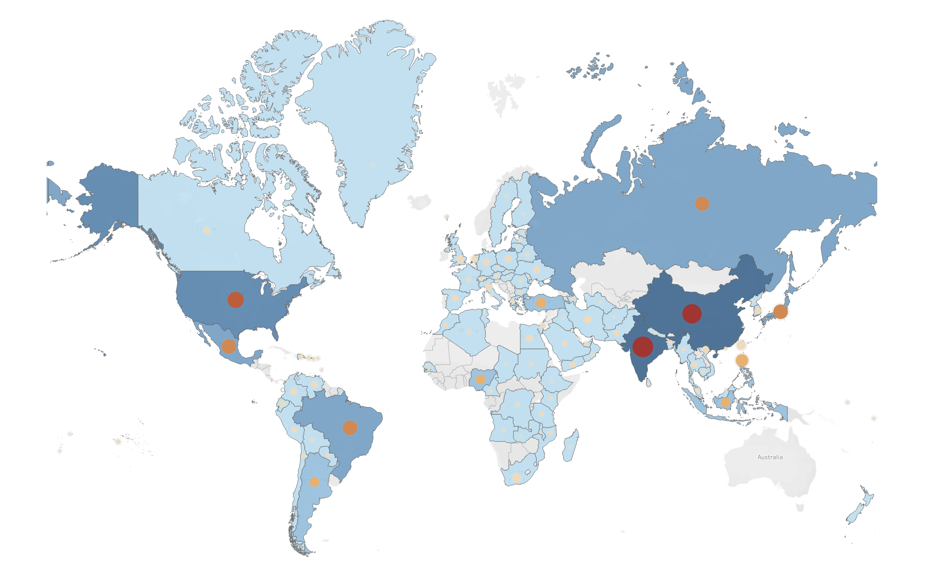
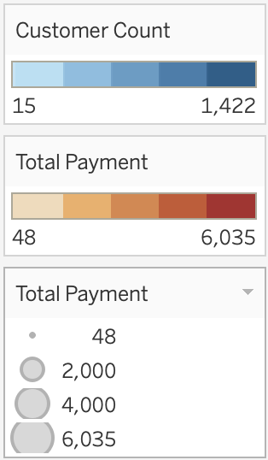
Customer Count and Revenue by Country
Rockbuster has customers worldwide. It seems that as the customer count increases, so does the revenue but is this true?

Slide 10
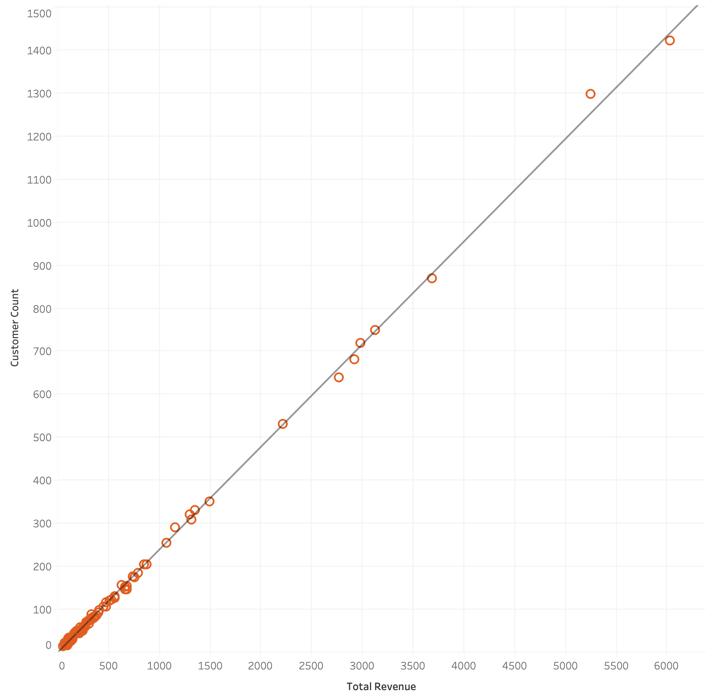
Correlation between customers and sales
The correlation chart to the right shows that there is a very strong correlation between number of customers and amount of revenue. As one increases, so does the other. The closeness to the line indicates the strong connection. So if this is true, where are the most customers located?

Slide 11
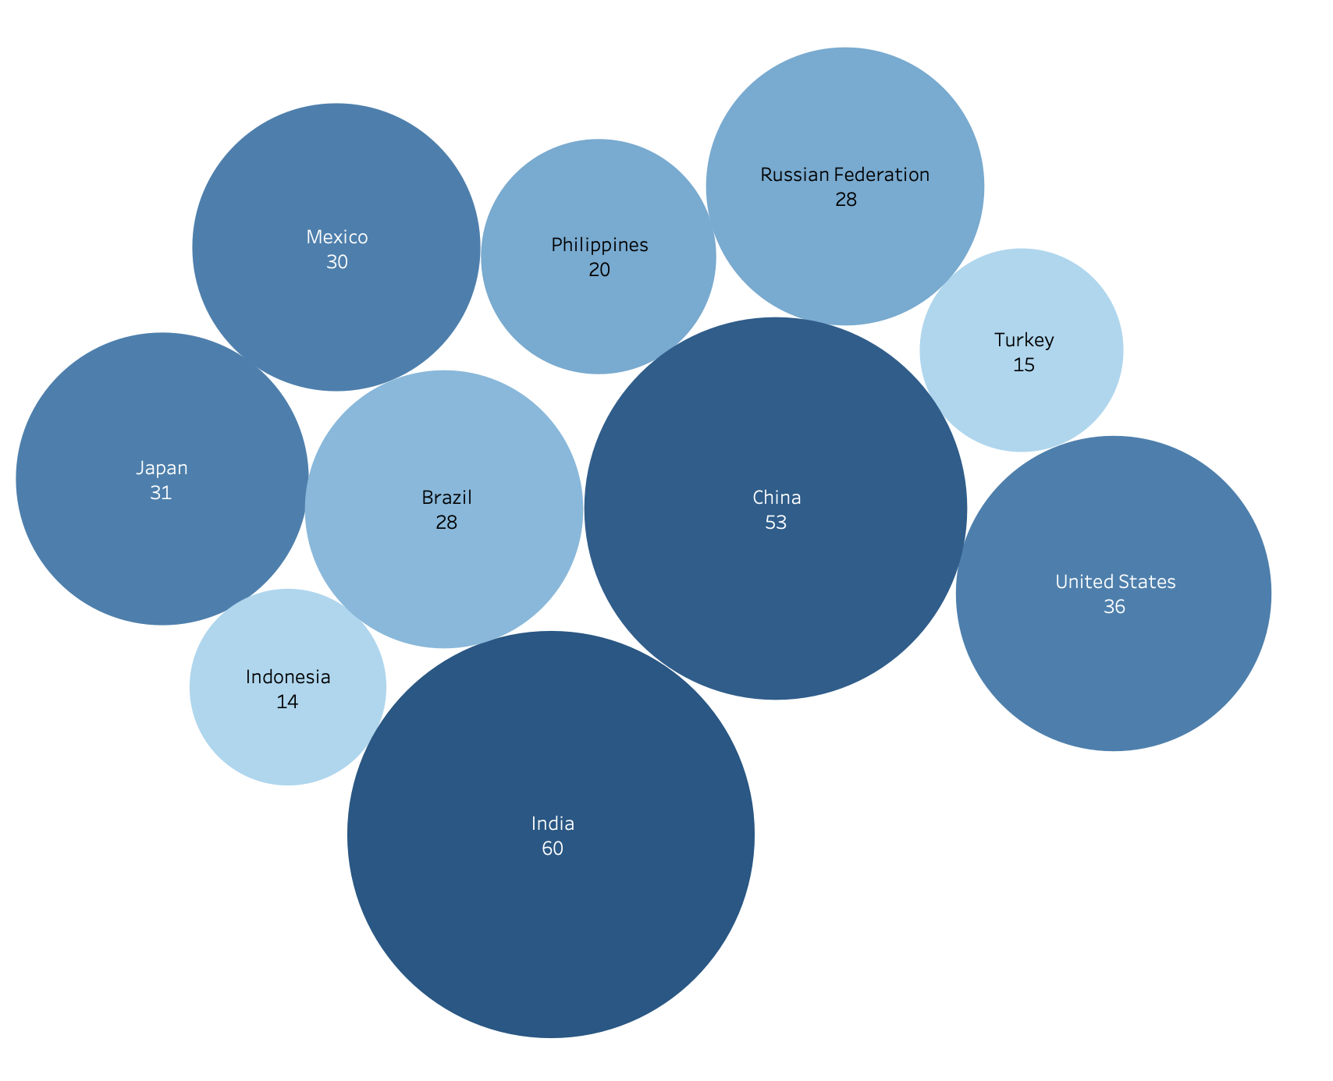
Top 10 Countries Based on Customer Location
The 10 countries with the most customers are shown to the right. India and China clearly have the most. If more customers mean more revenue, then these 10 countries would be good for starting a streaming service in.

Slide 12
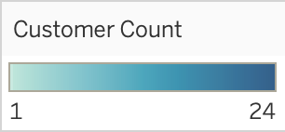
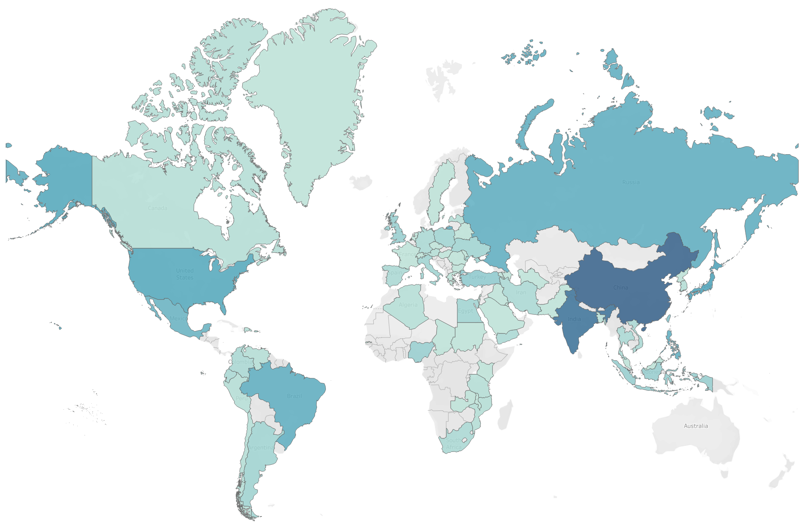
Top 250 Customers
This map shows the location of the top 250 customers based on the customer’s revenue.
Karl Seal
The top 5 customers are highlighted as requested for a potential rewards program.
Ana Bradley
Mike Way
Marcia Dean
Marion Snyder

Slide 13
Final Recommendations
Rockbuster customers live around the world. As customers increase, so do sales. We should target countries with large customer database to begin streaming service.
We should look at the top movies and categories to select which titles to begin streaming. We should avoid the bottom movie titles.

Slide 14
Thank You
Visualizations:
Tableau Visuals made by Bethany Reed
Email for SQL queries or any other questions: BethanyReed@rockbuster.com

